Slide 1
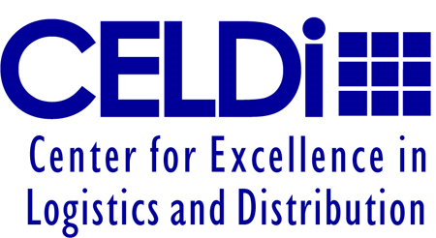
Next Generation Distribution System Michelin North America Research Team: Bill Ferrell (PI), Priya Devapriya, Mark McElreath
% Complete
0%
100%
We are investigating mode selection and load consolidation as a way to reduce transportation costs for frequent deliveries from a DC to customers.
Problem context
Broader Applicability
Any warehouse or DC with frequent shipments to
geographically dispersed customers
Multiple modes like TL, LTL and parcel all in use
Cost reduction opportunity by consolidating loads
Business and project objectives
Demonstrable cost savings in transportation
Must be feasible so include all customer and carrier constraints
Important/Expected Results
Excel based tool
Can be used by warehouse/DC manager
University Logo
Project #

